Slide 1

SAMSUNG PRISM
Generative AI
Hackathon
3rd Edition 2026 – 27
Theme ID - Theme 02 · Guided Troubleshooting
Team Name - Heavenly Restriction
College Name - [College name]
Member Name & Email 1 - Rajat Pandey · [email]
Member Name & Email 2 - Aryan Singh · [email]
Submission Github link - github.com/Blazehue/Samsung_PRISM-Sentinel
Live API & simulator - samsung-prism-sentinel.onrender.com
Notes:
Hi, we are team Heavenly Restriction — Rajat Pandey and Aryan Singh — on Theme 02, Guided Troubleshooting. We built SGTE, the Smart Guided Troubleshooting Engine. The code is on GitHub and the API and simulator are live on Render.

Slide 2
Theme 02 · Guided Troubleshooting
Galaxy users describe problems vaguely. Support has to turn that into the right steps, in the right order, with a one-tap link to the exact Settings screen.
What the API must return
1
Schema Goal → Actions → Step groups (kit's pydantic contract)
“My S22 screen goes blank when I open Gmail”
2
Grounded Every step taken from the SIIS article — never invented
“Swipe gestures go the wrong way after an app install”
3
One tap Exact deeplinks from the 578-entry masked catalogue
“My Flip 7 went black and I can’t move my data”
4
Safe order Least disruptive first, critical actions last
~15 min
of manual triage per scenario, across millions of interactions (Theme 2 guide)
5
Fast Repeats and paraphrases ≤ 300 ms; cold ≤ 8 s
6
Variations 8–10 paraphrases per query, varied registers
Notes:
Theme 2 asks for an API that takes a vague complaint plus a Samsung SIIS knowledge article and returns a structured, deeplinked troubleshooting plan. Steps must come from the article, links from a masked catalogue of 578 entries, and repeats must be answered in under 300 milliseconds.

Slide 3
Existing Solutions & Gaps
Manual agent triage
Search & FAQ bots
Plain LLM generation
An agent reads the article, picks steps and texts them to the user.
Return a whole article or the top snippets for the query.
A chatbot writes troubleshooting steps from scratch.
✕
~15 min per scenario
✕
Not a plan: no order, no categories
✕
Invents steps and URIs
✕
User navigates nested Settings alone
✕
Lands on parent menus, not the exact screen
✕
Seconds of latency and a cost on every query
✕
Quality varies by agent
✕
Nothing validates the fix
✕
Different answer each time
The gap Nothing delivers all four at once: steps grounded in the article, exact deeplinks, safe ordering, and sub‑300 ms answers for repeat questions.
Notes:
Today this is manual: an agent reads the article and texts steps, around fifteen minutes a scenario. Search bots return articles, not plans, and land on parent menus. A plain LLM is fluent but invents steps and links, and is slow and costly per query. Nothing gives grounded steps, exact deeplinks, safe order and speed together.

Slide 4
Our Solutions & Architecture Diagram
Rules decide, Gemini refines. Every step is copied from the article; every link comes from the catalogue.
IN
Complaint + SIIS article
0
Enrich
1
Structure
2
Deeplinks & order
4
REST API
query, siis_response
device · symptom · fix vs how-to · cache key
sections → actions · 1 interaction per step
exact label → 578 entries · auto → manual → critical
ContextDeeplinkResponse + meta
3
Fast-path semantic cache
2b Gemini refinement
deeplinks.json
578 masked entries, exact-label index
Cache misses only · topic names · “It will…” descriptions · closed-set link pick · variations · 5 s budget, model fallback
Exact repeat ~0.1 ms · paraphrase reuses the article's plan (~1 ms, byte-identical) · no-article semantic lookup
llm_cache.json
persistent Gemini results
Guardrails validated against the kit's schema.py · zero URL leaks · manual actions never carry links · fallback "no_match" / "no_siis_context" instead of invented steps · meta: latency, cache hit, model, cost
Notes:
The pipeline follows the guide's five stages. Stage zero enriches the query. Stage one parses the article into actions, one interaction per step, copied word for word. Stage two maps each step group to the exact catalogue entry and orders actions from least to most disruptive. Gemini only refines on cache misses — topic names, descriptions, a closed-set choice between catalogue candidates — with a five-second budget and a fallback. The cache answers repeats and paraphrases in about a millisecond.

Slide 5
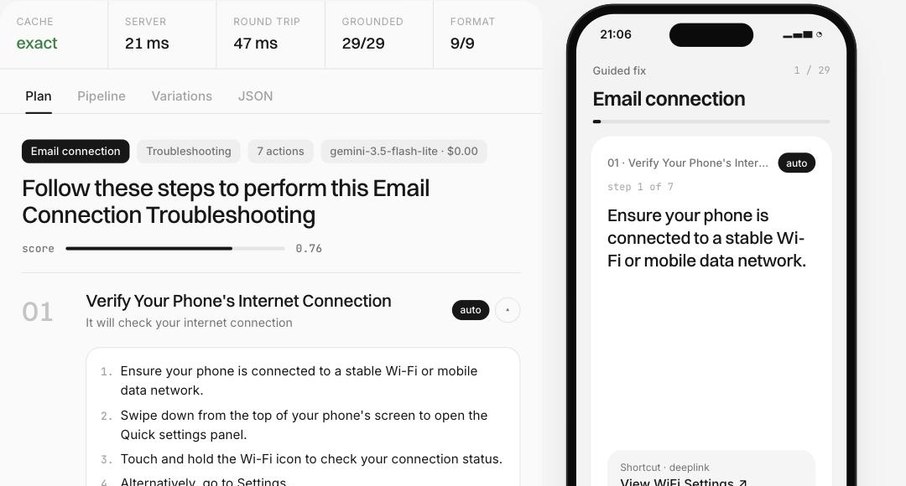
Demo & Product Walkthrough
1
Pick a case
20 kit cases, 14 unseen formats, or paste your own
2
Read the plan
goal, ordered actions, deeplinks + validation, 9 rule checks
3
Hit the cache
Repeat / Paraphrase → answered in ~1 ms
4
Walk it on the phone
open the deeplink, verify, confirm critical steps
5
Run the benchmark
every gate against the live API, from the browser
Live samsung-prism-sentinel.onrender.com Video [YouTube / Drive link, ≤ 5 min]
Notes:
Here's the simulator on the live deployment. We pick a kit case; the plan shows the goal, the actions in order, and each step group's deeplink and validation. Repeat and Paraphrase show cache hits in about a millisecond. The phone walks through the fix, opens the Settings screen and verifies it. The benchmark runs every gate from the browser.

Slide 6
Tools and tech stack used
Py
API
{ }
BM
Python 3.12
FastAPI + uvicorn
Pydantic v2
BM25 + embeddings
engine in pure Python — no model downloads
REST API and the simulator site, one app
validated against the kit's schema.py
hashed-vector retrieval over the 578-entry catalogue
G
Dk
✓
UI
Gemini 3.5 Flash-Lite
Docker on Render
pytest · 78 tests
HTML · CSS · JS
refinement stages, 3.1 Flash-Lite fallback
one container, live URL, env-only secrets
offline; Gemini stubbed; catalogue sweep
simulator + in-browser benchmark, no build step
Notes:
Everything is Python 3.12 and FastAPI, validated with Pydantic against the kit's own schema. Retrieval is BM25 plus hashed embeddings in pure Python, so cold starts are instant. Gemini 3.5 Flash-Lite refines plans, with 3.1 Flash-Lite as fallback. It ships as one Docker container on Render, with 78 offline tests.

Slide 7
Impact & Use case
Where it fits
~15 min → ~1 ms
→
Self-service in the support app
users get a plan with one-tap fixes instead of an article
manual triage vs a cached SGTE answer
1 tap
→
Contact-centre agent assist
agents send a validated plan in seconds, not minutes
deeplink to the exact Settings screen, then validated
→
Voice & assistant “fix it” flows
the deeplinks and validation keys map to device actions
$0.00
→
After an update
known issues answered from cache, consistently, at scale
per query on the free tier; cache hits never call a model
Notes:
Impact: a scenario that takes an agent around fifteen minutes is answered in about a millisecond once cached, with a one-tap deeplink and a validation check. It fits self-service, agent assist and assistant flows, at zero model cost for repeat questions.

Slide 8
Innovation highlights, results and limitations
Innovation
Results (live + metrics.md)
Limitations
Paraphrase cache reuses the article's plan — byte-identical to a fresh answer
All gates G2–G5 pass on the live URL
Goal names use a symptom lexicon; Gemini names unfamiliar topics
2.91 / 3 step accuracy
Gemini picks only from a shortlist of catalogue ids; a pick off the rules' screen is discarded
Verbatim rule caps completeness at 0.91 — prose advice isn't rewritten into steps
2.00 / 2 deeplink relevance · 572/572
Exact-label catalogue index: open vs on/off vs set-a-value
349 / 349 steps grounded
20 of 83 kit step groups link: the rest aren't Galaxy Settings screens
100% paraphrase hits (16 + 200)
One interaction per step, still word-for-word from the article
Free-tier Gemini overloads at times — the rules' answer is used
0.23 ms cache-hit p95 (server)
Persistent Gemini cache: live, local and results.jsonl agree
≤ 5.1 s cold p95 with live Gemini (limit 8 s)
No human-labelled ground truth in the kit; accuracy is scored against the articles
Notes:
Innovations: a paraphrase cache that is byte-identical to a fresh answer, Gemini constrained to a closed shortlist, and an exact-label catalogue index. Results: every gate passes on the live URL, step accuracy 2.91 of 3, deeplink relevance 2 of 2 across all 572 reachable entries, all 349 steps grounded, 100% paraphrase hits. Limitations are listed honestly on the right.

Slide 9
What’s next
Now
Next
Then
Later
Submitted
Engineer's view
Live SIIS + feedback
Multilingual & on-device
Live API, simulator, 78 tests, metrics.md
decision trace, grounding map, deeplink reasoning, regression diff
real articles and outcome telemetry grow the lexicon and eval set
Hindi and Korean queries; a small on-device model for refinement
As a PRISM worklet
Deterministic, auditable and cheap to run: the same answer for the same article, every link traceable to a catalogue entry, and a model used only where language understanding helps.
Notes:
Next we'd build an engineer's view that shows why each decision was made, connect live SIIS articles and outcome telemetry, and add multilingual queries and an on-device model. It's a good fit for a PRISM worklet because it is deterministic, auditable and cheap to run.

Slide 10
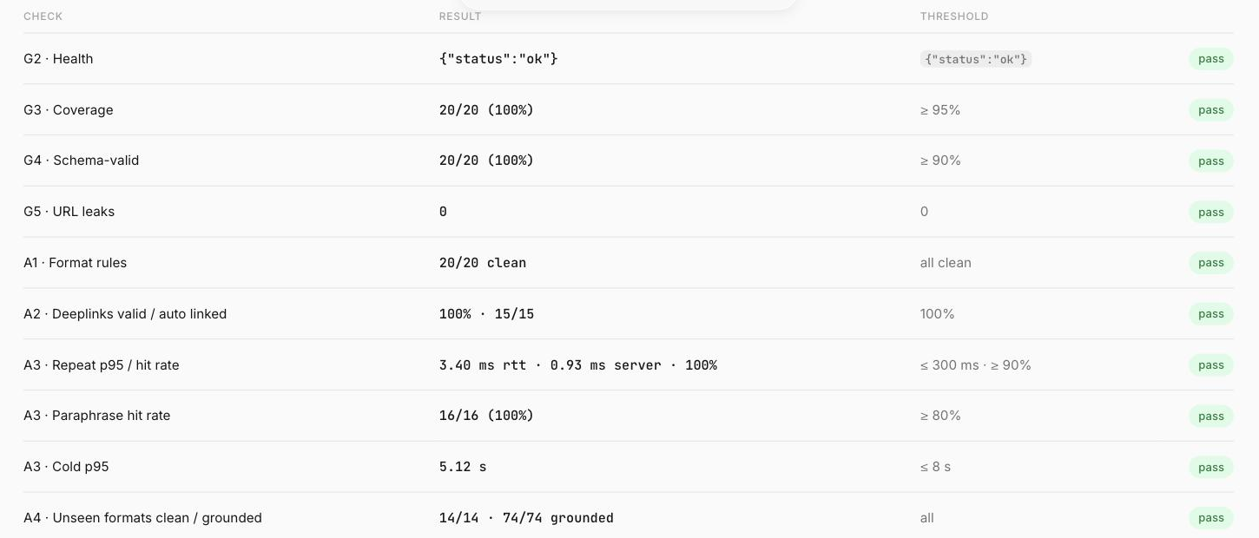
Brownie points (differentiation)
★
Phone simulator
deeplinks open a mocked Settings screen; validation and critical confirmation
★
Guide example reproduced
Appendix B swipe-navigation case links a real catalogue entry
★
Whole-catalogue sweep
572 / 572 step-reachable entries resolve correctly
In-browser benchmark against the running API — every gate passes
★
Gemini with guardrails
closed set, 5 s budget, model fallback, persistent cache
★
Honest metrics
metrics.md generated from real runs, with an ablation
Notes:
What sets us apart: a phone simulator that opens deeplinks and verifies them, the guide's own worked example reproduced with a real catalogue link, a sweep of the whole catalogue, Gemini used with strict guardrails, and metrics generated from real runs.

Slide 11
Checklist- Updated on Public GitHub
Y
Working prototype code — public or shared GitHub repo
github.com/Blazehue/Samsung_PRISM-Sentinel (private, shared) · live at samsung-prism-sentinel.onrender.com
Y
README with reproducible setup instructions
pip / uvicorn or Docker; architecture, results, configuration
Y
Demo video, max 5 minutes (YouTube or Drive link)
[link]
Y
Presentation file (PPT or PDF)
this deck · CollegeName_HeavenlyRestriction
Notes:
Checklist: code on GitHub, shared with the judges; README with setup and Docker; the demo video; and this deck.

Slide 12
Thank you
Heavenly Restriction · Rajat Pandey & Aryan Singh
samsung-prism-sentinel.onrender.com · github.com/Blazehue/Samsung_PRISM-Sentinel
Organised by the Language AI Team and the PRISM Team, Samsung R&D Institute India
Notes:
Thank you. Try it at samsung-prism-sentinel.onrender.com.

